Slide 2
GROUP MEMBERS
Name | Roll No
Athar Baig | 10EL40
Muhammad Faheem | 10EL38
Tassawar Javed | 10EL44
Tayyaba Abbas | 10EL09
Sadia Imtiaz | 10EL37

Slide 3
Ultrasonic Generation & Applications
Topic

Slide 4
Outline
Introduction to Ultrasonics
Properties of Ultrasonic waves
Ultrasonic Production- Magnetostriction Method
Ultrasonic Production- Piezo Electric Method
Applications of Ultrasonics

Slide 5
Introduction to Ultrasonics
The word ultrasonic combines the Latin roots ultra, meaning ‘beyond’ and sonic, or sound.
The sound waves having frequencies above the audible range i.e. above 20kHz are called ultrasonic waves.
Generally these waves are called as high frequency waves.
The field of ultrasonics have applications for imaging, detection and navigation.
The broad sectors of society that regularly apply ultrasonic technology are the medical community, industry, the military and private citizens.

Slide 6
Properties of ultrasonic waves
They have a high energy content.
Just like ordinary sound waves, ultrasonic waves get reflected, refracted and absorbed.
They can be transmitted over large distances with no appreciable loss of energy.
If an arrangement is made to form stationary waves of ultrasonics in a liquid, it serves as a diffraction grating. It is called an acoustic grating.
They produce intense heating effect when passed through a substance.

Slide 7
Ultrasonics Production
Ultrasonic waves are produced by the
following methods.
(1) Magneto-striction generator or oscillator
(2) Piezo-electric generator or oscillator

Slide 8
Magneto-striction Generator
Principle:
Magnetostriction effect
When a ferromagnetic rod like iron or nickel is placed in a magnetic field parallel to its length, the rod experiences a small change in its length. This is called magneto-stricion effect.

Slide 9
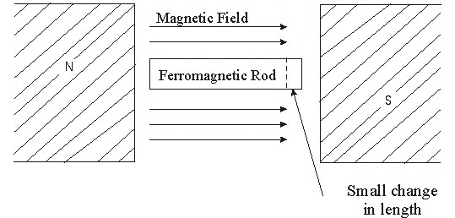
The change in length (increase or decrease) produced in the rod depends upon the strength of the magnetic field, the nature of the materials and is independent of the direction of the magnetic field applied.

Slide 10
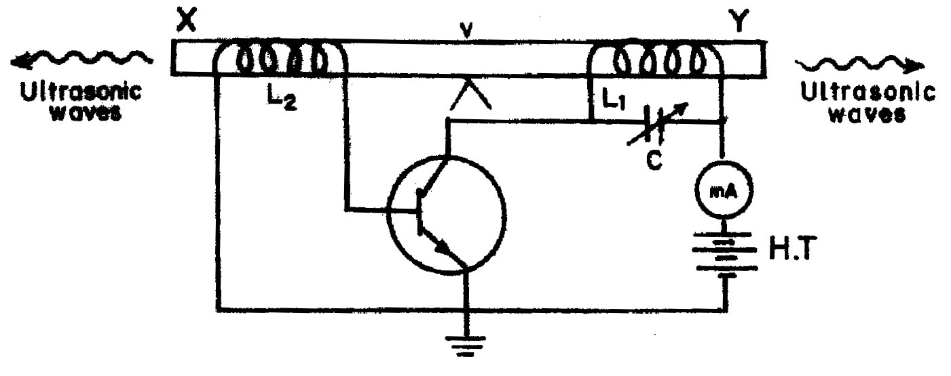
Construction
The experimental arrangement is shown in Figure
Magnetostriction oscillator

Slide 11
XY is a rod of ferromagnetic materials like
iron or nickel. The rod is clamped in the middle.
The alternating magnetic field is generated
by electronic oscillator.
The coil L1 wound on the right hand portion of the rod along with a variable capacitor C.
This forms the resonant circuit of the collector tuned oscillator. The frequency of oscillator is controlled by the variable capacitor.
The coil L2 wound on the left hand portion of the rod is connected to the base circuit. The coil L2 acts as feed –back loop.

Slide 12
Working
When High Tension (H.T) battery is switched
on, the collector circuit oscillates with a frequency,
f =
This alternating current flowing through the coil L₁ produces an alternating magnetic field along the length of the rod. The result is that the rod starts vibrating due to magneto-strictive effect.

Slide 13
The frequency of vibration of the rod is given by
n =
where l = length of the rod
Y = Young’s modulus of the rod material and
ρ =density of rod material
The capacitor C is adjusted so that the frequency of the oscillatory circuit is equal to natural frequency of the rod and thus resonance takes plate.
Now the rod vibrates longitudinally with maximum amplitude and generates ultrasonic waves of high frequency from its ends.

Slide 14
Advantages
The design of this oscillator is very simple and
its production cost is low
At low ultrasonic frequencies, the large power output can be produced without the risk of damage of the oscillatory circuit.

Slide 15
Disadvantages
It has low upper frequency limit and cannot
generate ultrasonic frequency above 3000 kHz (ie. 3MHz).
The frequency of oscillations depends on temperature.
There will be losses of energy due to hysteresis and eddy current.

Slide 16
Piezo Electric Generator or Oscillator
Principle : Inverse piezo electric effect
If mechanical pressure is applied to one pair of opposite faces of certain crystals like quartz, equal and opposite electrical charges appear across its other faces. This is called as piezo-electric effect.
The converse of piezo electric effect is also true.
If an electric field is applied to one pair of faces, the corresponding changes in the dimensions of the other pair of faces of the crystal are produced. This is known as inverse piezo electric effect or electrostriction.

Slide 17
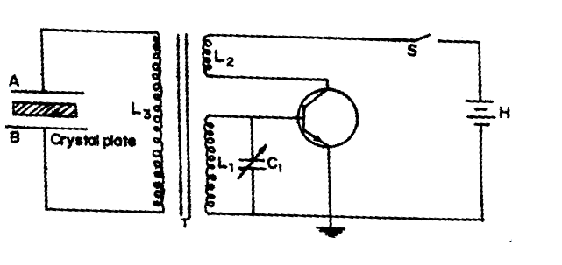
Construction
The circuit diagram is shown in Figure
Piezo electric oscillator

Slide 18
The quartz crystal is placed between two metal
plates A and B.
The plates are connected to the primary (L3) of a transformer which is inductively coupled to the electronics oscillator.
The electronic oscillator circuit is a base tuned oscillator circuit.
The coils L1 and L2 of oscillator circuit are taken from the secondary of a transformer T.
The collector coil L2 is inductively coupled to base coil L1.
The coil L1 and variable capacitor C1 form the tank circuit of the oscillator.

Slide 19
Working
When H.T. battery is switched on, the oscillator
produces high frequency alternating voltages
with a frequency.
Due to the transformer action, an oscillatory e.m.f. is induced in the coil L₃. high frequency alternating voltages are fed on the plates A and B.
Inverse piezo-electric effect takes place and the crystal contracts and expands alternatively. The crystal is set into mechanical vibrations.
The frequency of the vibration is given by
n=

Slide 20
where P = 1,2,3,4 … etc. for fundamental, first over tone, second over tone etc.,
Y = Young’s modulus of the crystal and
ρ = density of the crystal.
The variable condenser C₁ is adjusted such that the frequency of the applied AC voltage is equal to the natural frequency of the quartz crystal, and thus resonance takes place.
The vibrating crystal produces longitudinal ultrasonic waves of large amplitude.

Slide 21
Advantages
Ultrasonic frequencies as high as 5 x 108Hz or 500 MHz can be obtained with this arrangement.
The output of this oscillator is very high.
It is not affected by temperature and humidity.

Slide 22
Disadvantages
The cost of piezo electric quartz is very high
The cutting and shaping of quartz crystal are very complex.

Slide 23
Applications of Ultrasonic Waves in Engineering
(1)Detection of flaws in metals (Non Destructive Testing –NDT)
(2) Ultrasonic Drilling
(3) Ultrasonic welding
(4) Ultrasonic soldering
(5) Ultrasonic cutting and machining
(6) Ultrasonic cleaning
(7) SONAR

Slide 24
Applications of Ultrasonics in Medicine
(1)Diagnostic sonography
(2)Ultrasound therapeutic applications
(3)Ultrasonic blood Flow meter

Slide 25
Some Other Applications of Ultrasonics
(1) Ultrasonic guidance for the blind
(2)Ultrasound in research

Slide 26
THANK YOU FOR YOUR ATTENTION
Any question?

