Slide 2
X-RAY
Group Members
Ali Raza Khan
Ali Raza
Gulraiz Munzoor
Kamran Zafar
Usman Yousif

Slide 3
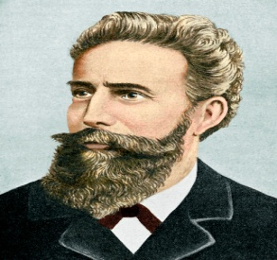
X-RAY GENERATION
Wilhelm Roentgen discovered X-rays in 1895. Roentgen sent electrons through an evacuated discharge tube. He used a very high voltage across the tube to give the electrons a large kinetic energy. When the electrons struck the glass wall of the tube there was a glow on a bright screen a short distance away. The glow continued even when if a piece of wood was placed between the tube and the screen. He concluded that highly penetrating rays were from the discharge tube.

Slide 4
X-RAY GENERATION
In his report Röntgen called the newly discovered rays “X-rays” to indicate that their nature was unknown. The rays were also later called Röntgen rays in honor of the distinguished achevement.

Slide 5
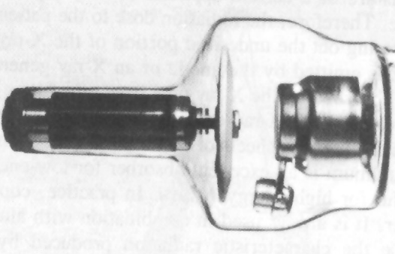
X-RAY GENERATION
Made of cast steel & is usually lead-lined. Provides for absorption of most off-focus radiation.
Wavelengths of x-rays is 0.001 to 10nm.
electrons → accelerated by10³ to 10⁶V.
The energy of x-ray photons is E = hv.
λ_{visible} = 600 Angstroms, λ_{x-rays} = 1 A, λ_{gamma rays} = 0.0001 A

Slide 6
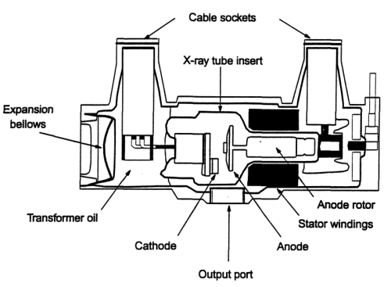
X-RAY GENERATION
The major components of the modern X-ray tube are:
cathode (electron source).
anode (acceleration potential).
rotor/stator (target device).
glass/metal envelope (vacuum tube).

Slide 7
X-RAY GENERATION
X-rays was created whenever high-energy electrons suddenly gave up energy. Machines produce x-rays by accelerating electrons to extremely high speeds and then crashing them into a piece of solid material called a target. There, the electrons rapidly slowed down because they collide with atoms in the target, and part of the energy is changed into x-rays.

Slide 8
X-RAY GENERATION
Most applications of X-rays are based on their ability to pass through matter.
The penetrating power of X-rays also depends on their energy.
The more penetrating X-rays, known as hard X-rays, are of higher frequency and are thus more energetic.
It depends on the wavelength of the x-rays not on the number of x-ray photons.
while the less penetrating X rays, called soft X-rays, have lower energies.

Slide 9
X-RAY APPLICATIONS
Industrial.
Medical.

Slide 10
INDUSTRIAL APPLICATIONS
Industrial radiography:
is the use of ionizing radiation to view objects in a way that cannot be seen otherwise. Industrial manufacturers use a testing method called “radiography” to check for defects in metal parts and welds before products are put on the market. Radiography allows the examination of an object without affecting its usefulness (such methods are referred to as Nondestructive Inspection or NDI).

Slide 11
INDUSTRIAL APPLICATIONS
Industrial radiography uses two types of radiation: x-rays and gamma rays. X-rays used in industrial radiography are produced by an x-ray generator, which is large and used in a fixed location. Similar to medical x-ray machines, radiation is present only when these machines are turned on.

Slide 12
INDUSTRIAL APPLICATIONS
Airport security:
Both hold luggage and carry-on hand luggage are normally examined by X-ray machines using X-ray radiography.
Non-intrusive cargo scanning:
high-energy X-ray radiography are currently used to scan intermodal freight cargo containers in US and other countries.

Slide 13
MEDICAL APPLICATION
x-ray enables the atoms and molecules to be ionized and this characteristic is quite useful in medical treatment.
The x-rays used in clinic treatment is mainly for cancer. It is found that x-rays can induce a series of biological effects in human body (ionizing, Compton effect, producing electron-positron pairs). They can damage especially the biological tissue cells which are active in fission. Cancer cells are such cells. Therefore, the x-rays can kill them or at least can reduce their fission speed.

Slide 14
MEDICAL APPLICATION
Fluoroscopy and photography :
As different parts and organs in human body have different absorbing abilities of x-rays, the homogeneous intensity of x-rays will be not homogeneous after penetrating human body. If the non-homogeneous x-rays are projected onto fluorescent screen, the image of the organs can be formed on the screen. This is called x-ray fluoroscopy.
If the transmitted x-rays irradiate on a negative film, the picture can be seen after development. The technique is called x-ray photography.

Slide 15
MEDICAL APPLICATION
CT Scanner:
CT Scanner: Computerized Tomography Scanner: an x-ray machine that can produce stereographic images (former name: CAT Scanner (Computer-Aided Tomography)).

Slide 16
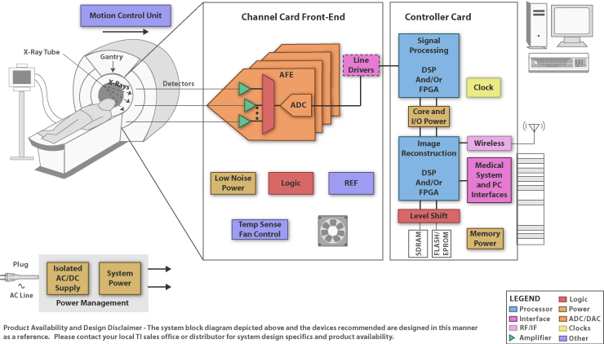

Slide 17
DANGER & PRECAUTION
A danger associated with X-rays is the extremely high voltage that occurs. In human beings an overdose exposure of X-rays may produce cancer, skin burns, and a reduction of the blood supply or other serious conditions. In plants or animals they may damage or even destroy living tissue.
One precaution that can be taken to avoid these dangers is the use of a lead shield, because X-rays can not penetrate through it. Try to target the spot needed only, to avoid the dangers.

Slide 18
ADVANTAGES & DISADVANTAGES
Advantages:
Widely used and available.
Experts available.
High-spatial resolution.
Excellent imaging of hard tissues (bones).
Disadvantages:
Radiation exposure.
Diﬃculty in imaging soft-tissues.
2D projection, hidden parts.

